Slide 1
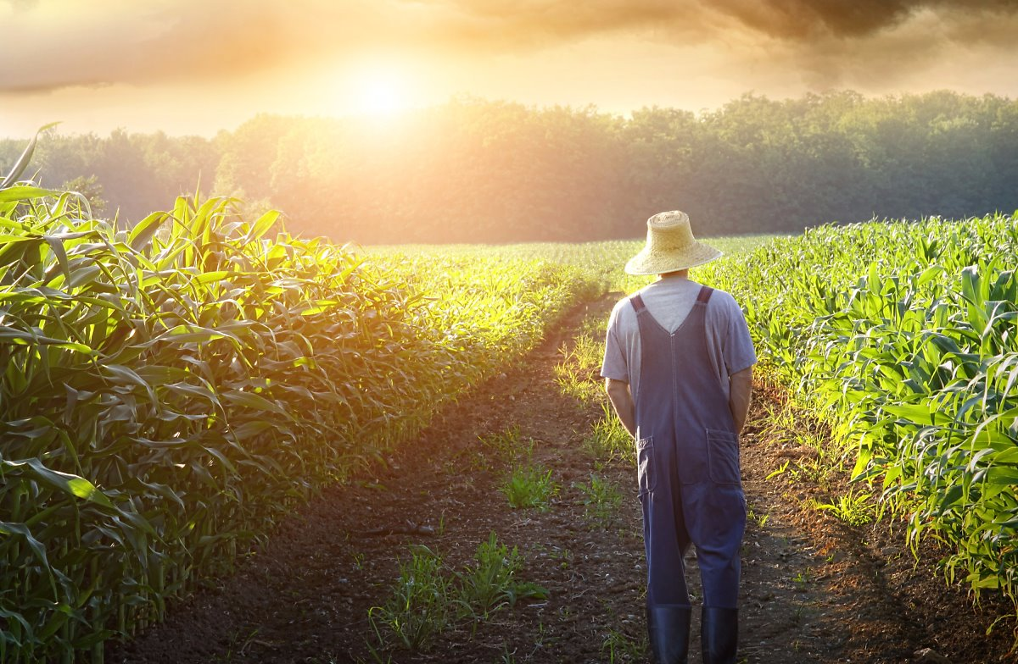

Development of Korean Agriculture and
Digital Agriculture
for Future
Cho Yong-been, RDA

Slide 2
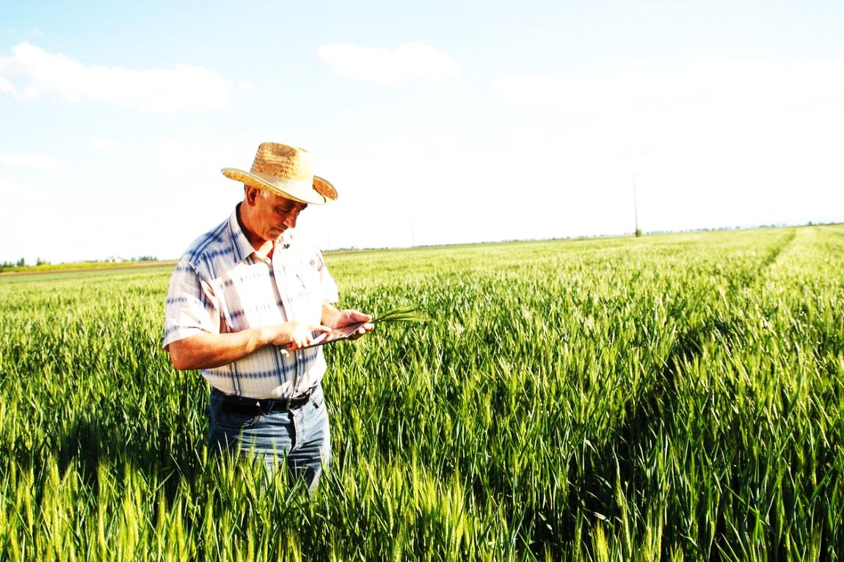
Contents
Development of Korean Agriculture
Digital Agriculture for Future
Utilization of Smart Farm Big Data
Case of Productivity Improvement Model(AI)
AI Platform Service

Slide 3
1
1
Development of
Korean Agriculture

Slide 4
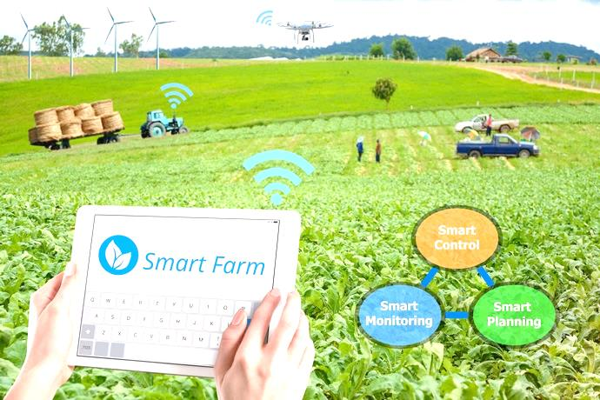


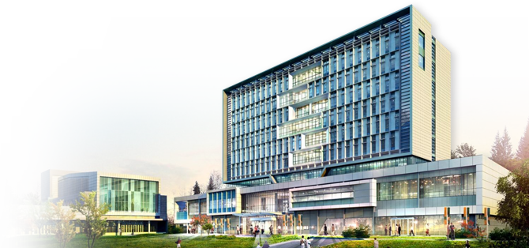
About RDA and its Mission
Inauguration
1962. 4. 1.(Suwon) 2014. 9. 15.(New office at Jeonju)
Organizational
Structure
HQ (4Bureaus)
Agricultural Technology
Affiliated Research Institutes(4)
Administrator
Spokesperson
Vice
Administrator
Audit & Inspection Office
International
Cooperation
R&D
Dissemination
Extension
Planning & Coordination Bureau
Research Policy Bureau
Extension Service Bureau
Technology Cooperation Bureau
NAS
NICS
NIHHS
NIAS
National Institute of
Agricultural Sciences
National Institute of
Crop Science
National Institute of
Horticultural &
Herbal Science
National Institute of
Animal Science
Personnel
1,847
※ Researcher, extension worker: 68.2%
(1,164 researchers, 96 extension workers)
Welfare
improvement of
farmers
Stable food supply to people
Competitiveness improvement of
agri-industry
Revitalization of
rural community
Budget
KRW 938.1billion(2018)
4/32

Slide 5
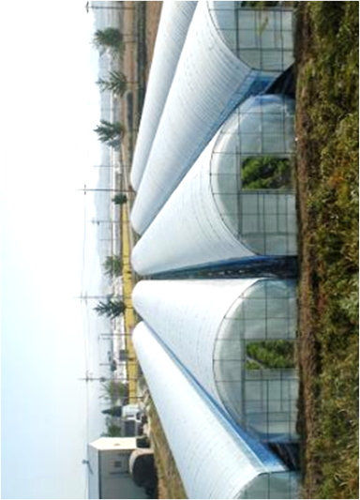
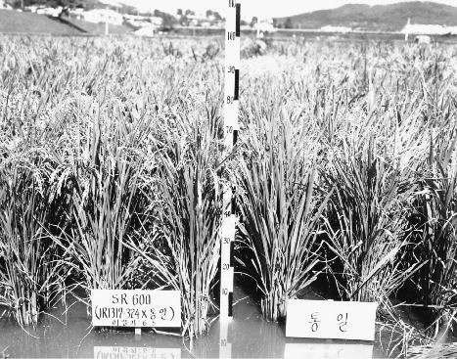




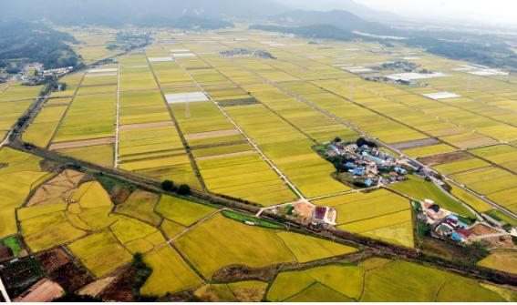
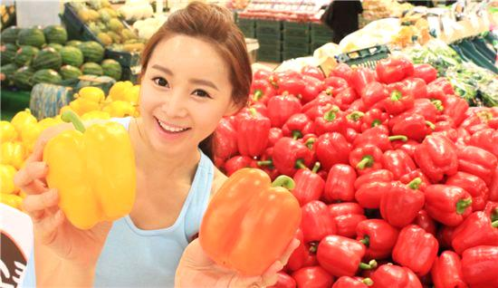

RDA Roles per Decade
1960s~1970s
1980s~1990s
2000s~
Tong-il Rice
Development
Green House
Production
Consumption
Observation
Distribution
Rural
Green Revolution
White Revolution
Quality Revolution
Value Revolution
Bio Revolution
4th Industrial Innovation
Self-sufficiency of
staple crop
Year-round supply of
vegetable
6th Industrialization
5/32

Slide 6
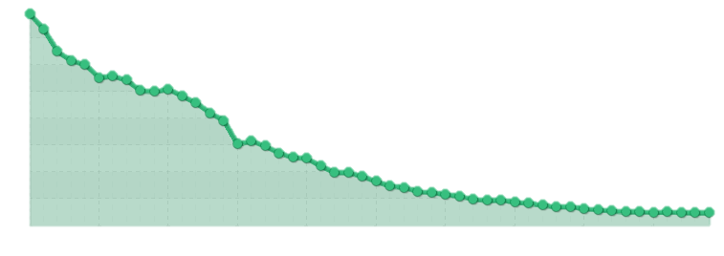

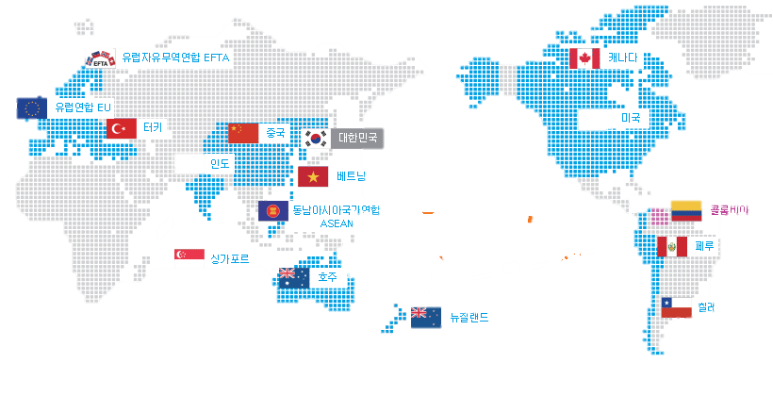
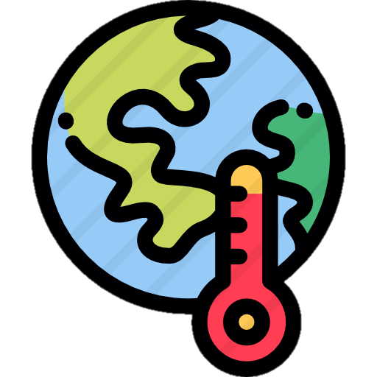
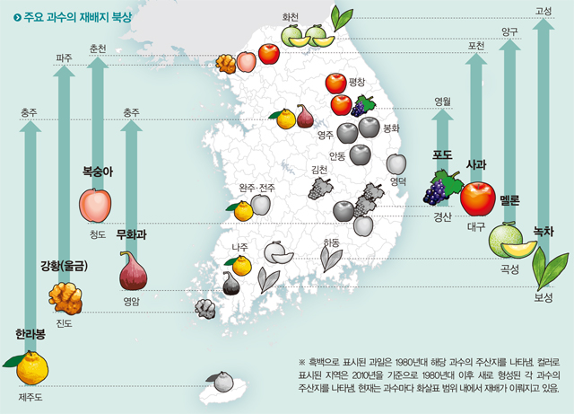
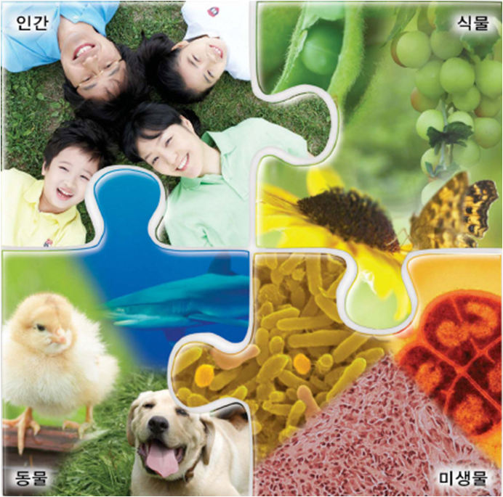
Current Situation of Korean Agriculture
Agricultural GDP Stagnation
Acceleration of Market Opening
Rep. of Korea
Korea’s FTA Status
(%)
15 FTAs entered into force with 52 countries,
(as of Feb. 2017)
40
39.4%
Added-Value(% of GDP)
Ranked #3 in economic territory
30
25.4%
(Korean FTA market GDP volume/Global GDP)
20
12.5%
Ranked #109 in
nation’s territory
10
5.8%
5`
3.1%
2.4%
(Except North Korea)
0
1965
1975
1985
1995
2005
2010
Major fruit’s cultivation area going north
4th Industrial
Revolution
Climate Change
Demand on agricultural innovation
건강/행복
부가가치
신기술
사물인터넷
기능성
빅데이터
인공지능
드론
환경/보존
농업의
4차 산업혁명
경쟁력
스마트
사물인터넷
FTA
디지털
자동화
순환에너지
FTA
빅데이터
인공지능
먹거리
6/32

Slide 7
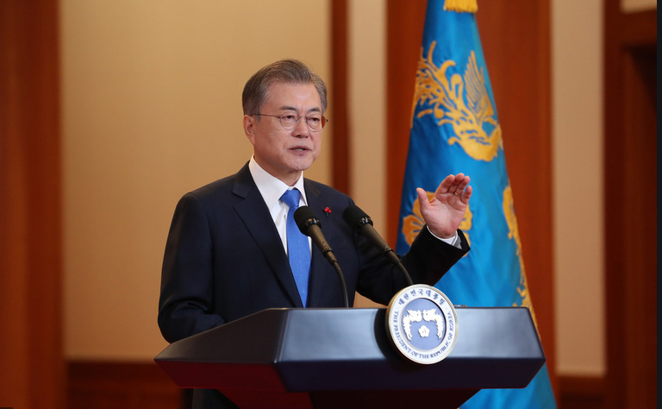
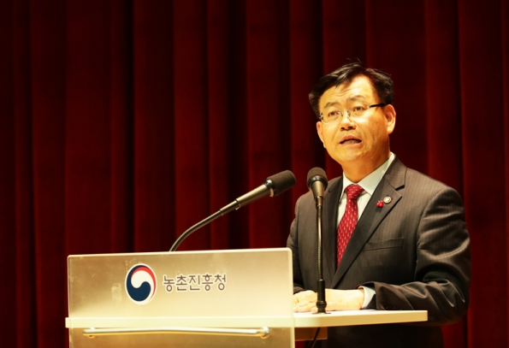
Request for New Innovation in Agriculture
Achievement Creation that sensed by farmers and the people
President Moon Jae-In’s
New Year’s Address
RDA Administrator Kim Kyeong-Kyu
Focus on achievement creation by taking priority over two major tasks including digital agriculture…(2019)
Select smart farm through leading project for innovative growth …(2018)
Smart farm innovation valley, Project fostering young experts
Digital agricultural technology, scientific use and management of microorganism
7/32

Slide 8
2
Digital Agriculture
For Future

Slide 9
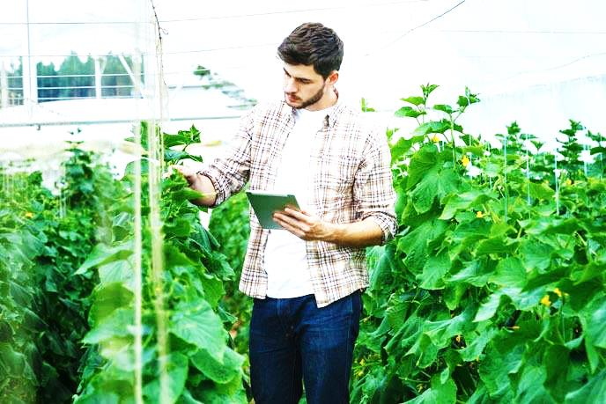

Data-based Digital Agriculture
Digitalize agricultural phenomenon through big data, AI, and intellectual robot, and realize precision agriculture by returning its solution practically
Digital Agriculture
IoT, Satellite
+
Realize customized production,
distribution, and consumption through
“Digital Agriculture”
+
+
Drone
Intelligent Robot
Platform
Agriculture
+
+
AI
(Deep Learning,
Machine Learning)
Big Data
9/32

Slide 10





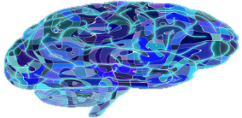
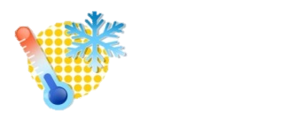

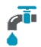
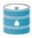
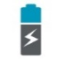
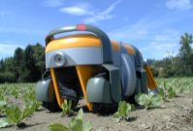
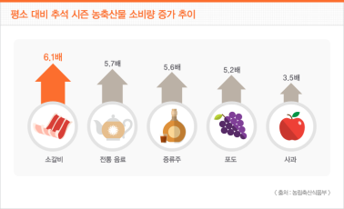
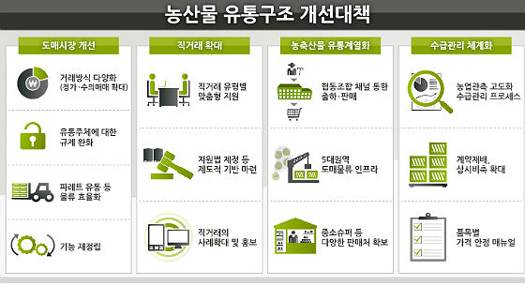




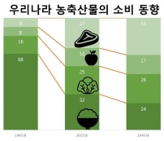

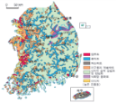
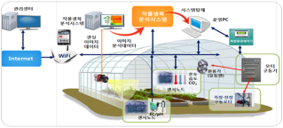
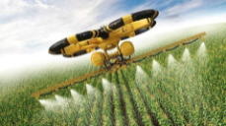
Data-based Digital Agriculture
Promotion of digital agriculture through realization
of agriculture big data-based AI
Utilization in Agriculture
Promising ago-food exploration
Right land selection
Smart production
Smart distribution and sales
Farm profit increase
Reduce cost
Increase quality
Increase yields
Set appropriate price
AI Technology in Agriculture
Apply AI technology in agriculture
Artificial Intelligence(AI)
Computer program that imitates intelligent thinking and action of human
Customized sales strategy
Control time and yield
Control environment
Predict crop that
consumption increases
Direct mobile transaction
Development of promising crop and variety
Right crop for right land
AI-based smart production
Satellite, robot, and drone for agricultural use
Consumption prediction and supply and demand control
Smart distribution and sales of agro-food products
10/32

Slide 11
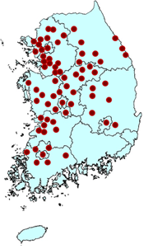

Establishing the digital agriculture system
Proceeding Digitalization by agriculture field and step
Breeding
Environmental Data
Develop new variety that meets market demand through analyzing big data on genome, climate change, population structure, and consumption pattern
Provide soil information and
predict weather as well as pest and disease through collection and analysis of IoT-based data
Genome information
Building system to use owning genetic resources by decoding genetics
Developing molecular marker based on genome information
Conduct research on new breeding technique such as CRISPR/Cas9
Soil
Web-service for fertilizer prescription
Nutrient balance calculation program
Weather
Early warning service for abnormal weather
Pest and Disease
Technology for identification of initial disease symptom of crop
11/32

Slide 12


Establishing the digital agriculture system
Proceeding Digitalization by agriculture field and step
Growth Data
Cultivation
Develop technologies to collect crop’s growth data
Improve productivity and quality using big data and AI technologies
Facilities
Sensing technology for crop environment
Robot for growth measurement
Livestock bio-capsule
Land
Measurement technology for crop growth, pest and disease, and soil nutrient using drone and satellite
Information Collection
Collect large size data with various types in each area
Information Analysis
Develop AI that improves productivity and profit using big data
Service
Support selection and cultivation of crop using AI-based solution
12/32

Slide 13

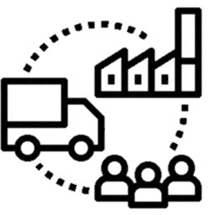
Establishing the digital agriculture system
Proceeding Digitalization by agriculture field and step
Distribution & Consumption
Rural Livelihood
Support stable supply and demand in a way such as precision prediction of main vegetable yields
Develop and disseminate ICT-based alarm system and safety device for farmers
Distribution & Consumption
Develop AI for yields prediction using big data on major main vegetable
Establish smart storage system to control supply and demand of major vegetable
Develop packaging technology that maintains freshness of fruit
Support decision making on production and distribution of agricultural products through analyzing big data on consumption trend
Accident Detection
Accident detection and alert system applying wireless communication technology among traffic sign, agricultural machine unit, and smart phone
Environment Detection
Develop safety risk factor detection equipment for farmers
Safety Equipment
Develop and disseminate safety vest for farmer, single-wheel cart maintaining balance automatically, individual shield for heat illness prevention
13/32

Slide 14
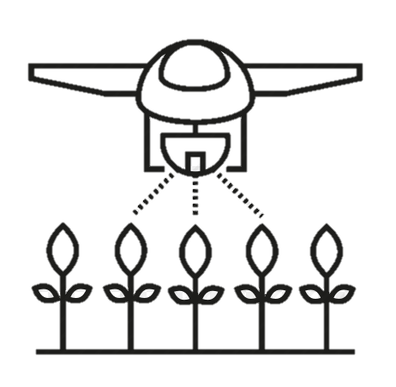
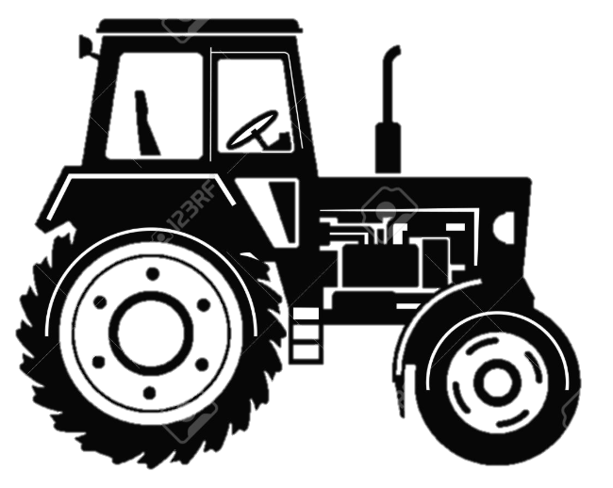
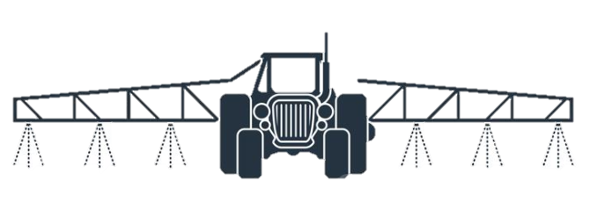
Establishing the digital agriculture system
Intelligent Agricultural Machinery Development and Utilization
using Autonomous Driving Technology
Pest Control Machine
Drone
Tractor
Develop technologies for farm work such as sowing and pest control with using unmanned air vehicle
Develop tractor prototype available for autonomous driving and farm work
Develop autonomous driving pest control robot for unmanned pesticide spraying
Hardware
Apply 65-horsepower HST frame for autonomous driving(transmission, steering)
Software
Develop autonomous driving algorithm that drives after deciding route with using deep learning technology
Hardware
Develop smart pest control machine possible to identify fruit by laser sensor
Software
Develop technologies for fruit identification and opening and closing control of injection nozzle using laser sensor(LIDAR)
Pest and Disease Control
Disseminate precision spraying technology for pesticide
Crop Evaluation
Establish crop information service-based technology using unmanned air vehicle
14/32

Slide 15
Establishing the digital agriculture system
Cloud Platform Establishment and Sharing and Utilizing the information
Data
Platform
Establish “Agriculture Big Data Center” for big data collection and storage
Establish cloud platform for agriculture data sharing and utilization
Collection System
Establish bottom-up data collection system that establish big data in cooperation with rural development institutions for the data-based scientific farming
Standardization
Lay a ground for collection, analysis, and utilization of data per area with establishing cloud-based big data by standardizing agriculture data
Activity
Establish analysis, utilization and sharing platform using integrative technologies on information searching, big data and AI in connection with professional data center in agriculture
Utilization Plan
Set basic direction on data convergence and joint utilization among related institutions, and provide analysis and utilization service of big data through cloud platform
15/32

Slide 16
3
Development of
Productivity Improvement Model(AI)
using Smart Farm Big Data

Slide 17
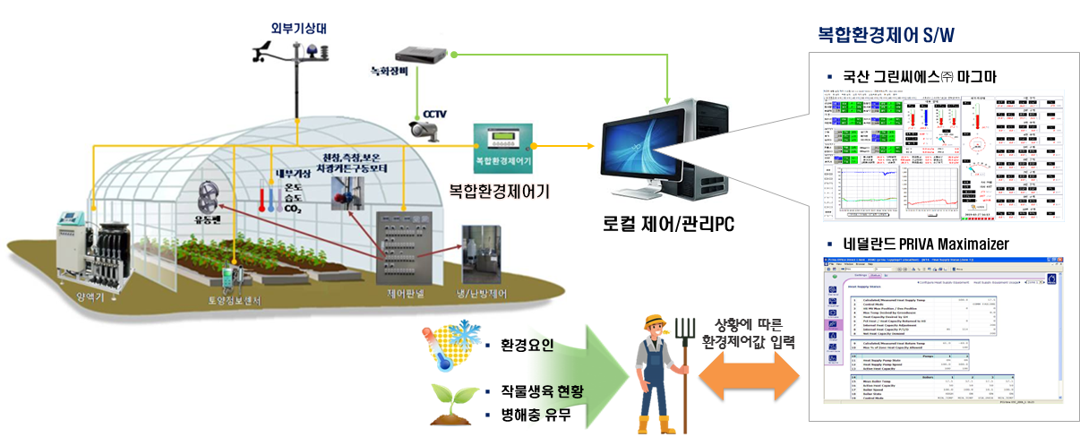
Concept of Smart Agriculture
Smart farm : ICT + Agricultural production(protected)
→ Pursues convenience and productivity
17/32

Slide 18
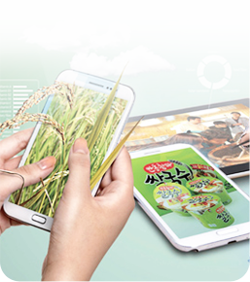
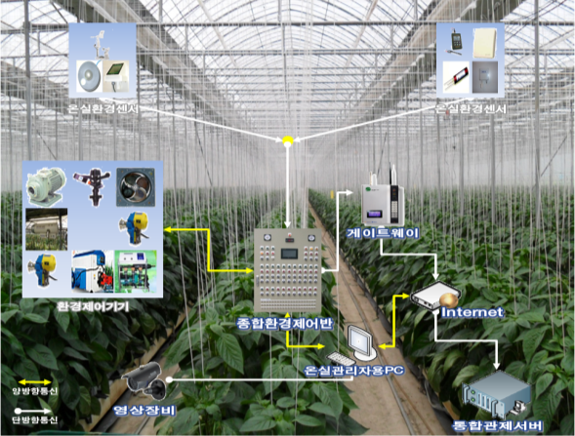
Development Stage of Korean Smart Farm Technology
Third Generation
(2020)
Complex energy management + smart farm work
☞ Export-oriented
Smart greenhouse system
Second Generation (2018)
Complex environment control + Cloud service
☞ Big data analysis ⇒
Better productivity
and product quality
First Generation
(2016)
Remote monitoring + Remote control
☞ Improved convenience for farm work
Farm households adopting the first generation smart farm experienced better productivity and quality
Tomato
(Production amount)
84kg/3.3㎡
Strawberry
(income)
21.5%
1,438만원/10a
44.6%
1,183
65
Non-smart farm
Smart farm
Non-smart farm
Smart farm
18/32

Slide 19
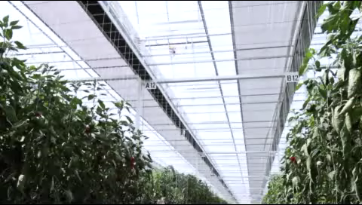
Development of Productivity Improvement Model Using Big Data(AI)
What is Smart Farm?
19/32

Slide 20
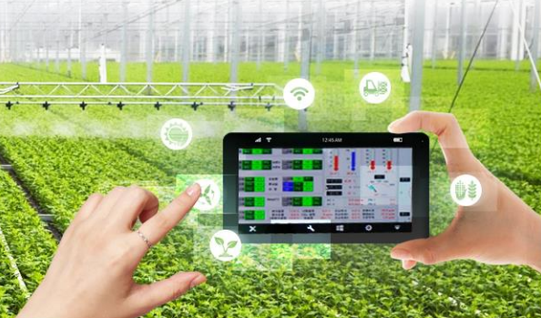
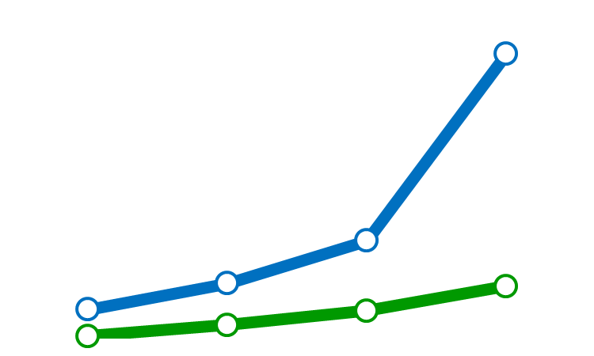
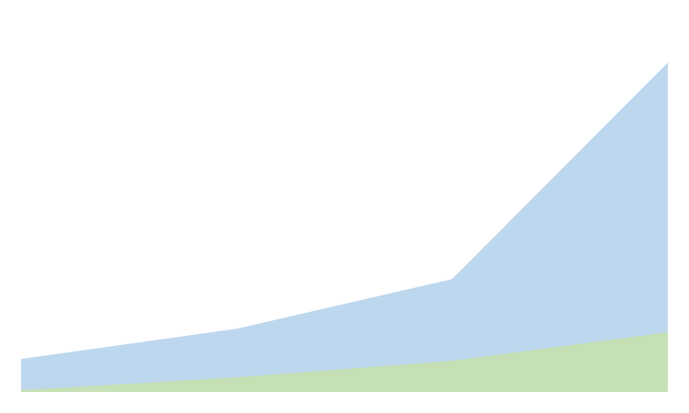
Smart Farm Cultivation Status and Plan
Protected horticulture: 7,000 ha of land(2022)
Livestock: 5,750 farms
4,000 ha
405 ha
Horticulture
Livestock
730Farms
30Farms
2014
2015
2016
2017
20/32
Notes:
그림 다시 그릴것

Slide 21
Problems Awareness in Smart Farm
Farmer’s thinking and problem
Satisfaction(10) : convenience of farming(7.3) > reducing labor(6.9) > increasing productivity(6.0)
Problem of establishing smartfarm (MAFRA, `16): Initial investment & management expense(53.8%)
Requirement of increasing crop productivity
Utilization of environment & growth information(92.0%), overall consulting using big data(84.0), education of control system84.0)
Problem of smartfarm system(Netherlands) & research in Korea
(PRIVA, Netherlands) Optimization of environment growth, yield for NL, Not Korea
Different to environment condition(radiation)
(IT research Institute, Korea) predicting the tomato yield model using environment data
* Predicting the tomato yield (multiple regression) (※ difficult to use result for farmer)
21/32
Notes:
그림 다시 그릴것

Slide 22
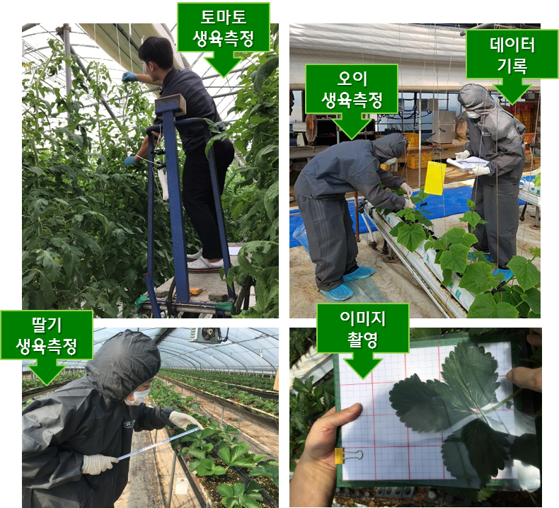
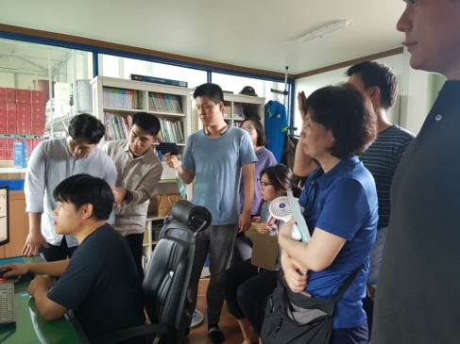
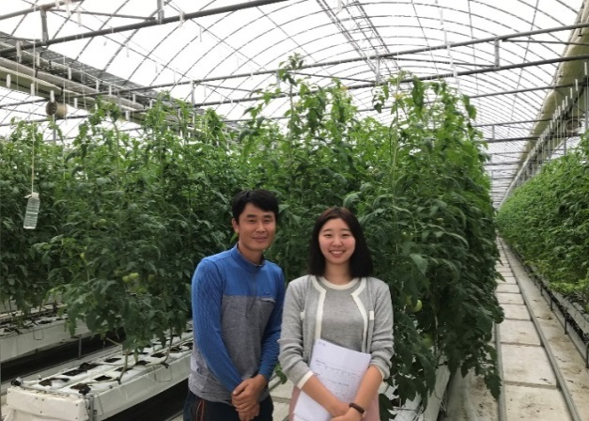
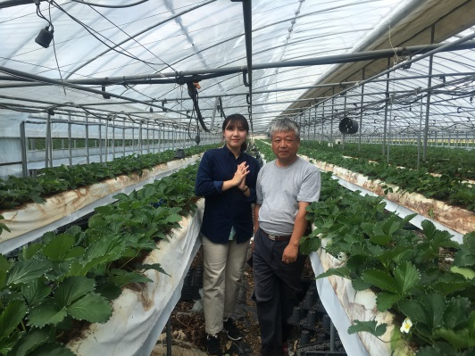
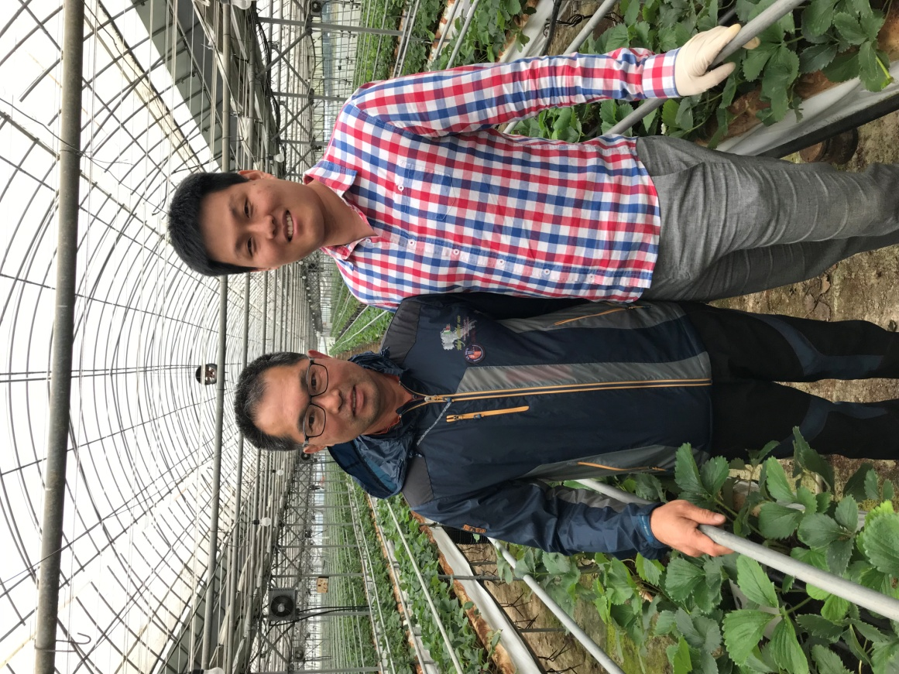
Data Collection of Smart Farm
Training researcher in smart farm : 75 people
Gyeonggi(9), Gangwon(8), Chungbuk(3), Chungnam(10), Jeonbuk(9), Jeonnam(13), Gyeongbuk(12), Gyeongnam(9), Jeju(2)
<Training and Consulting>
<Data Collecting for Growth and Image>
22/32
Notes:
그림 다시 그릴것

Slide 23
Data Collection of Smart Farm
Status on Farm Collected Big Data for Smart Farm Life Cycle
Number of farm(environment, growth, yield): 280 farms (2019)
Crop: Tomato(including cherry tomato), paprika, strawberry, oriental melon, cucumber, mushroom, flower, etc.
Crop |  |  |  | 2016 | 2017 |  | 2018 | 2019 | 2020 Goal
 |  |  |  |  | Initial | Revised
S M A R T F A R M | Tomato | Ripened Tomato |  | 8 | 14 | 49 | 73 | 60 | 30
 |  | Cherry Tomato |  | 2 | 8 | 23 | 33 | 20 | 50
 | Strawberry |  |  | 3 | 21 | 45 | 73 | 60 | 30
 | Paprika |  |  | 2 | 11 | 32 | 45 | 40 | 30
 | Oriental melon |  |  | 3 | 3 | 5 | 21 | 20 | 30
 | Cucumber |  |  | - | - | 7 | 7 | 10 | 20
 | Flower |  |  | - | - | 14 | 24 | 10 | 10
 | Mushroom |  | King Oyster Mushroom | 3 |  | 3 | 6 | 10 | 10
 |  |  | Oyster Mushroom | 3 | 3 | 2 | 10 | 10 | -
 | Pig |  |  | 3 | 20 |  | 23 | 20 | -
 | Total |  |  | 27 | 80 | 180 | 315 | 280 | 210
23/32
Notes:
그림 다시 그릴것

Slide 24
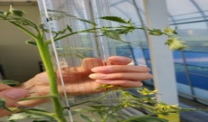
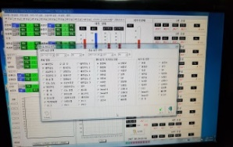
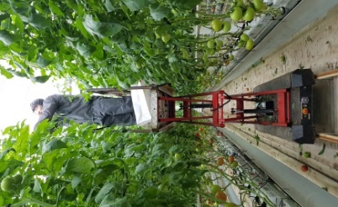
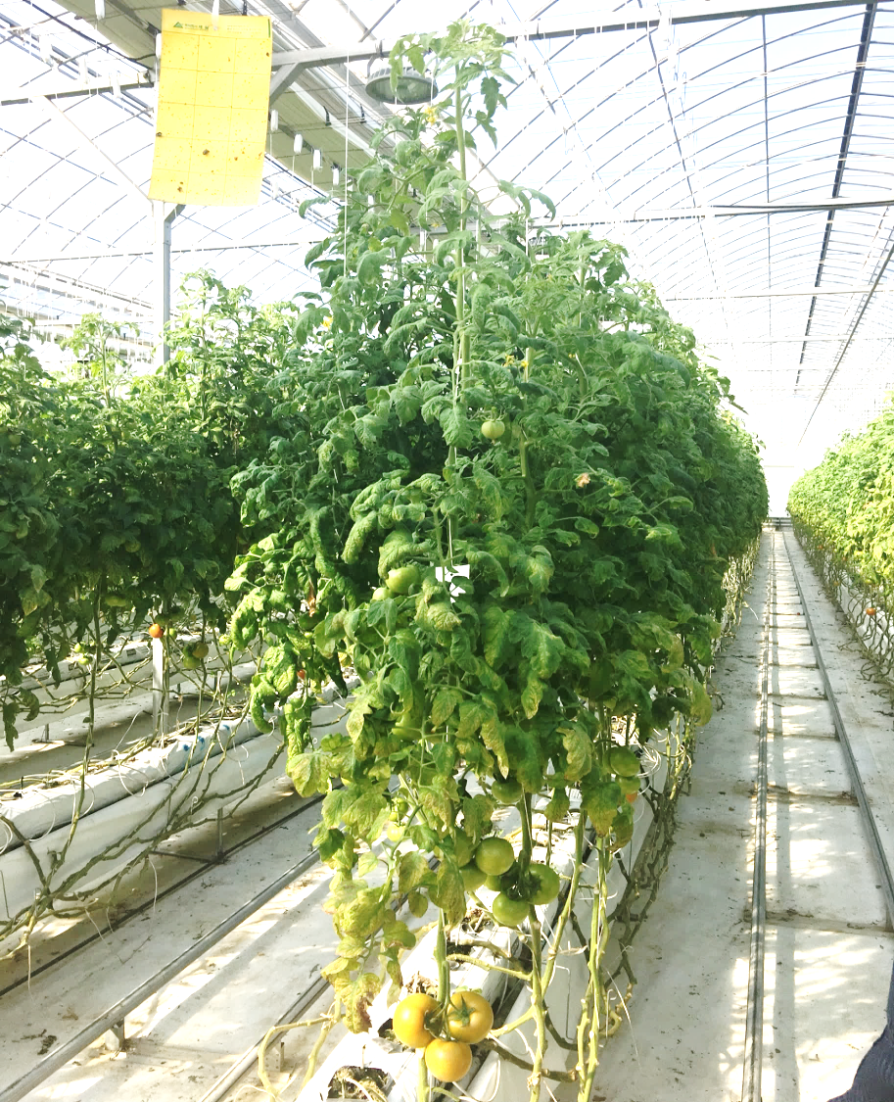
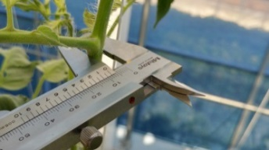







Development of Productivity Improvement Model using Big Data(AI)
Optimal Growth
Environment condition
(temperature) 22℃
(RH) 79%
(CO₂) 357ppm
(giftEC) 2.7dS/m
Growth length : 19.2 cm
7 flower cluster
Flowering
Stem diameter : 11.3 mm
6 flower cluster
5 flower cluster
Fruit setting
Size: 29.58mm
Color: Green
Fertilization
4 flower cluster
3 flower cluster
Fruit enlargement
Size: 44.30mm
Color: Green
Fruit enlargement
Size: 40.66mm
Color: Green
2 flower cluster
1 flower cluster
Fruit enlargement
Size: 54.74mm
Color: Green
Harvesting
Size: 58.01mm
Color: Orange
24/32

Slide 25





Process of Productivity Improvement Model using Big Data
Case of Development on Optimal Environment Setup Model for Tomato
Data Collection
<Items collected : Farm environment (ground, root zone) , growth, yield>
<Physiological characteristics of tomato>
<Development Process of Basic Model> : Environment → Yield(7~13weeks), Growth → Yield(2~10weeks), Environment → Growth(2weeks)
Algorithm Development
<Short-term environment setup development for appropriate growth (middle stage, Jan.~Feb.)>
<Drawing growth items and appropriate growth level affecting yield>
Utilization
Basic Model Algorithm
(Environment setup for cultivation period)
Big data team, RDA research institute, provincial agricultural research & extension services
Specialized Model Development
(Physiological stress, pest and disease, etc.)
Company, university, RDA research institutes
Utilization by Farmers
25/32

Slide 26
Result for Development of Productivity Improvement Model
The Short-term Environment Condition Setup for Maintaining Optimal Growth
Controlling the growth level using environment condition,
- Result: Can harvest 150~160 kg/3.3m² ( the smartfarm average productivity : 84kg /3.3㎡) → productivity 85%↑
Period |  | Average | Beginning | Middle(month) |  |  |  | End
 |  |  |  | 9~10 | 11~12 | 1~2 | 3~6
High productivity(kg/3.3㎡) |  | 3.9 | 3.9 | 2.7 | 3.9 | 3.9 | 4.3 | 4.0
Average productivity(kg/3.3㎡) |  | 2.2 | 1.6 | 2.1 | 2.2 | 1.8 | 3.0 | 2.5
Average harvest weeks |  | 40 | 3 | 4 | 7 | 9 | 13 | 4
Growth | Growth length (cm) | 19.5 | 27.0 | 16.9 | 20.3 | 13.8 | 18.9 | 18.6
 | Stem diameter(mm) | 10.0 | 12.3 | 9.3 | 10.0 | 9.4 | 8.0 | 8.0
 | Height of flower(cm) | 20.0 | 23.8 | 13.5 | 13.7 | 25.8 | 16.2 | 16.9
Environment Condition | Radiation (J/㎠) |  | 1772~2441 | 1078~1330 | 993~1146 | 817~999 | 1393~1628 | 1751~1985
 | 24h Temperature (℃) |  | 20.2 | 22.0 | 17.8 | 16.4 | 19.2 | 21.4
 | Daytime temperature (℃) |  | 27.2 | 24.3 | 20.0 | 19.0 | 21.9 | 24.3
 | Nighttime temperature (℃) |  | 14.9 | 19.5 | 16.2 | 14.5 | 16.4 | 18.1
 | Daytime RH (%) |  | 79.8 | 80.3 | 80.1 | 85.0 | 73.9 | 71.5
 | Number of water/1 day |  | 23 | 15 | 12 | 6 | 22 | 24
 | Water amount/1 time (cc./day/plant) |  | 86 | 71 | 57 | 86 | 59 | 51
 | Supply EC(dS/m) |  | 2.6 | 2.5 | 3.3 | 2.7 | 2.4 | 2.5
 | Supply pH |  | 5.5 | 5.7 | 5.7 | 5.7 | 5.1 | 5.8
26/32
Notes:
표 내용 확인 후에 변경 할것 변경

Slide 27
Result for Development of Productivity Improvement Model
The short environment condition setup for maintaining optimal growth
Middle Stage(Nov, Dec))
Distance from growing point(this week) to growing point (prior week)↑,
distance of growing point and flower cluster↓(②→① )
: Inside temperature↑, nighttime temperature ↑, supply EC ↑
distance of growing point and flower cluster↓(③→①) : supply water ↓, supply EC ↑
 | Growth stage |  |  | Environment condition(radiation: 993~1146J/cm²)
Productivity (kg/3.3m²) | Distance from growing point ( this week ) to growing point ( prior ) (cm) | Stem diameter(mm) | Distance of grow ing point and flower cluster ( cm) | Inside 24h. temp . (℃) | Daytime Temp. (℃) | Night time Temp. (℃) | Daytime RH (%) | Supply EC | Supply pH | Number of water | Water amount (cc./day/plant)
3.8 | 20.3 (17.9~20.6) | 10.0 (9.8~10.9) | 13.7 (13.4~17.9) | 17.8 | 20.0 | 16.2 | 80.1 | 3.3 | 5.7 | 12 | 57
2.7 | 18.8 (17.9~20.6) | 10.3 (9.8~10.9) | 17.5 (13.4~17.9) | 17.5 | 20.2 | 15.5 | 73.0 | 2.6 | 5.4 | 11 | 80
2.1 | 21.5 (20.6~23.8) | 11.0 (10.9~11.8) | 20.8 (17.9~21.5) | 17.8 | 20.6 | 15.5 | 81.0 | 3.1 | 5.5 | 10 | 75
1.8 | 22.4 (20.6~23.8) | 11.9 (11.8~16.9) | 25.6 (21.5~26.0) | 18.4 | 22.2 | 15.8 | 74.5 | 2.5 | 5.7 | 11 | 79
0.7 | 20.5 (17.9~20.6) | 10.3 (9.8~10.9) | 17.4 (13.4~17.9) | 17.8 | 20.7 | 15.8 | 82.3 | 2.6 | 5.9 | 11 | 72
①
②
③
☞ Possible to support short-term decision-making by comparing growth stage and crop status by season in own farm
27/32
Notes:
단어 변경 (growth level-> growth stage

Slide 28
4
Artificial Intelligence(AI)
Platform Service

Slide 29









Cloud Platform Service for Digital Agriculture
Big Data Collection
Cloud Service Platform
Private Sector
(Company)
Smartfarm:280 farms
Main vegetable
: 120 farms
Experimental field: 119
Crop Growth Measurement Robot: 3
Data Collection & Management
Data Opening
Secure data set
Environment: Automation
Growth/Management: Manual
Support on connecting with third party
Data set use
Model Development Support
RDA
Data Analysis & Model Development
Use of external expert
Specialized model development
Basic Model
Platform Provision
Specialized model platform provision
Service Provision
Farmer & Consumer
Basic Model Development
Comparative Analysis on Suitable Growth Environment Setup of Smartfarm
Service Provision
Production, distribution, consumption, service utilization
29/32

Slide 30













Big Data Platform Service for Smart Farm
Farm Service Setting AI-based Appropriate Growth Environment
Farm
(Data Input)
Introduction Service on
Internal Environment
Farm
(Service Provision)
1
2
5
6
7
Appropriate Temperature 23℃
Farmer A
<Smart Farm A>
Drawing appropriate greenhouse environment per farm
<Smart Farm A>
<Environment Data>
Data Convergence
Prepare consulting message
Appropriate Temperature 20℃
3
4
<Growth Data>
Data Analysis
Farmer B
<Smart Farm B>
Productivity Increase
(Greenhouse environment/yield)
<Smart Farm B>
<Yield Data>
Appropriate Humidity 75%
Productivity Improvement Model
Appropriate Growth Status
(Greenhouse environment/Growth)
Farmer C
<Smart Farm C>
<Smart Farm C>
30/32

Slide 31








Establishment of Innovative Growth Ecosystem for Digital Agriculture
RDA
Technology Transfer of Basic Model & Dataset Provision
Data Collection and Processing & Basic Model Development
Basic Model Development
& Cloud Platform Operation
Specialized Model Development using Basic Model and Dataset
Data & Management Knowhow Provision
Specialized Model & Business Model Development
Agriculture Big Data Provision
Smart Farm
Company
Smart Farm
Farmer
Innovative Growth Ecosystem using Agriculture Big Data
Company Sales Increase
Job Creation
Productivity Improvement
Farm Income Increase
Business Model Service Provision
Business Model Application to Farm
31/32

Slide 32
The 4th industrial revolution,
We will develop it through advanced digital agriculture.
Thank you.

